Slide 1
Artificial Intelligence IoT wireless Mesh monitor device (“WizardMesh”) for homeland security by: Dr. Nissim Zur www.TelnT.com nissim@telnt.com

Slide 2
The problem with for homeland security Name tag is not active device
TelnT’s WizardMesh™ Solution
A person in a secure aria is not monitored
No ability to detect un authorize person enter to un authorize arias
PIR (Infra-Red ) sensors are not reliable.
Has no Wi-Fi connection
Easy to mask
No Artificial Intelligence processing in device
No detection trap of person, in room, is case of fire or alarm
No long wireless mesh chain messages
The WizardMesh design to added layer of security to buildings/security areas.
Ability to detect people by their phone MAC address.
No need any apps on the phone.
Ability to detect peoples in room by Wi-Fi RF Doppler effect when they moved in the room
Support wireless Wi-Fi, BLE , BTL all mesh to very long range, a strong anti-jamming capability,
Possible add any other sensors as fire/smoke/etc…
Ability to report a position of any unregister human in any place in the building
Ability to automatic open door to authorized people.
wireless logger people location with distance to any WizardMesh™ with date and time.
See https://youtu.be/6zFE1XOokZ4
Technologies
The problem
The Solution
Notes:
2

Slide 3
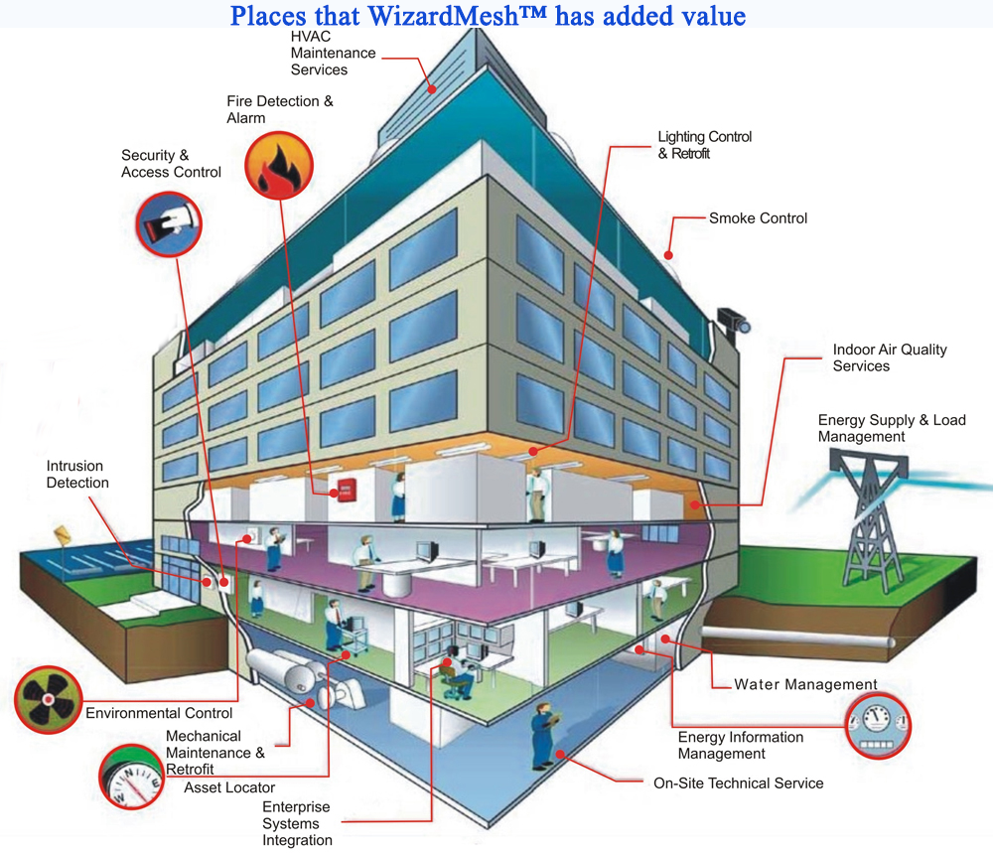
Artificial Intelligence Wireless WizardMesh™
Notes:
3

Slide 4
TelnT CEO: Dr. Nissim Zur nissim@TelnT.com TEL: +972-54-4500635 (Israel)
TelnT focuses on unique owned Artificial Intelligence algorithms patented
Zero competitors on the WizardMesh™ device so far (1-8-2017).
11 patents. 2 granted already.
Company value 100M USD, looking for 15M USD investment for expansion and world wide marketing
www.TelnT.com nissim@telnt.com
Skype: nissim.test

